Slide 1
Functions flow of control
Like conditionals, functions change the flow of control through the program
statement
statements in the function may be used many times as the program runs
function call
statement
statement
statement
function call
statement
statement

Slide 2
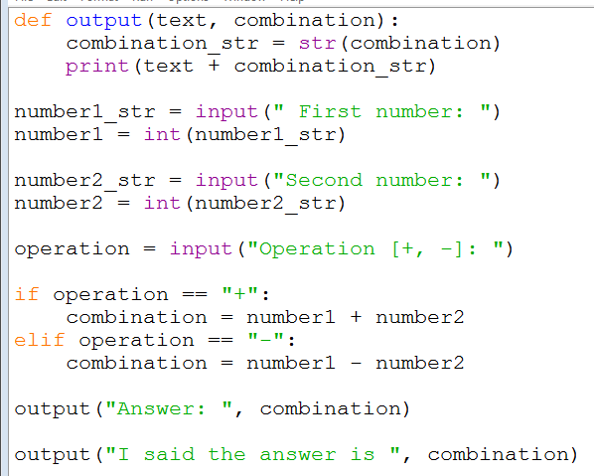
Functions – file structure
In Python, functions are written (defined) at the top of the program
The main part of the program is written after the functions are defined
function(s) – there may be several
the main part of the program

Slide 3
Functions – execution
When you run a program, the execution of the code starts at the top of the main program
after any function(s) are defined
this is usually not the top of the file!
The execution proceeds down the file, one statement after another
It then drops down into the functions as they are invoked
And returns back to the main program once the function has been executed
notice that in this case the code inside the function has been executed twice

Slide 4
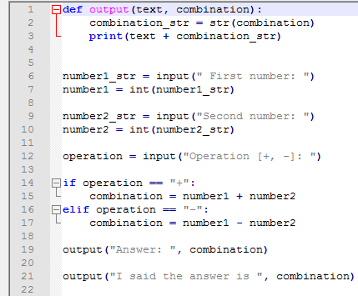
Quick Check
On what line does the execution of the program start
answer: line 6
In what order are the statements executed (what are the line numbers)
answer: 6, 7, 9, 10, 12, 14, (15 or 16, 17), 19, 2, 3, 21, 2, 3

Slide 5
Debugging (& Recap)
Chris Walshaw
Computing & Information Systems
University of Greenwich

Slide 6
Lecture Objectives
Reminder: course structure & assessment
Python basics
statements
flow of control
operators
comments
PyCharm
installation & configuration
debugging
other features

Slide 7
Motivation
This is traditionally recap week
We will go over some of the topics that have been mentioned in previous lectures and look at them in more detail
We will also look at how to debug programs
First of all there have been a number of queries about whether the tutorial exercises count towards the final mark

Slide 8
Tutorial work
Each week you should
try to do the tutorial exercises in the labs – talk to your tutor if you are stuck
try to finish them off at home, if necessary
read the suggested w3schools pages
watch me working through selected solutions at the start of the lecture
review the solutions on Moodle – ask your tutor if you still don’t understand
try again to do any that you couldn’t do first time around

Slide 9
Reminder: Assessment
Exam
Sometime in week commencing 7th January 2019 – do not miss it!!
Worth 100% of your COMP1753 marks
20 questions
multiple choice
open book
About learned programming skills rather than memory
you should easily pass the exam if you have made a good attempt at all the tutorial work (including reviewing & retrying questions you couldn’t do)

Slide 10
Open book?
An open book exam means that you can look at material during the exam
COMP1753 lectures, examples & solutions
the internet
your logbook
any books you choose to bring (within reason)
So it makes sense to keep your files organised and your logbook up to date

Slide 11
Python basics
We shall now review some of the basic ideas of Python that we glossed over initially

Slide 12
Syntax
A computer program is a list of “instructions” to be “executed” by the computer
In a programming language like Python, these instructions are called statements
Python statements are composed of
Variables – e.g. name, age
Values (literals) – e.g. 7.5, "Hello "
Operators – e.g. = , + , - , * , /
Expressions – e.g. 5 * 10, cost * 2
Keywords – e.g. if, else, def, return
Comments – e.g. # this is a comment
https://www.w3schools.com/python/python_syntax.asp

Slide 13
Statements
Programs are composed of statements, e.g.
print("Hello world") is a statement
year_of_birth = year – age is a statement
Each Python statement is on a new line
Indentation is meaningful in Python
used to indicate the body of function or a conditional
The statements are executed, one by one, usually in the same order as they are written
when a conditional statement (if / elif / else) is used only some of the statements may be executed
when a function is invoked, the statements inside the function are executed before carrying on to the next statement after the invocation

Slide 14
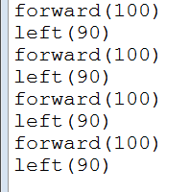
Flow of control
Typical flow of control is one statement after another, down the program
statement 1
statement 2
for example, to draw a square
statement 3
statement 4

Slide 15
Conditional flow of control
Conditionals change the flow of control through the program
if the condition is not true, these statements are never executed
statement
if condition
condition true
statement
condition false
statement
statement

Slide 16
Functions flow of control
Like conditionals, functions change the flow of control through the program
statement
statements in the function may be used many times as the program runs
function call
statement
statement
statement
function call
statement
statement

Slide 17
Operators
Operators operate on values
Usually they are called binary operators because they operate on two values, e.g.
message = "Hello "
result = (3 - 2)
Some operators can also be unary if they operate on a single value, e.g.
negative_value = -value
“=” is a binary operator
“=” is a binary operator
“-” is a binary operator
“=” is a binary operator
here “–” is a unary operator

Slide 18
Operators
There are several different types of operators in Python including,
Arithmetic: + , - , * , /
Assignment: = , +=
Comparison: == , != , > , < , >= , <=
Logical: and , or , not
Membership: in
There are also some others we haven’t met yet

Slide 19
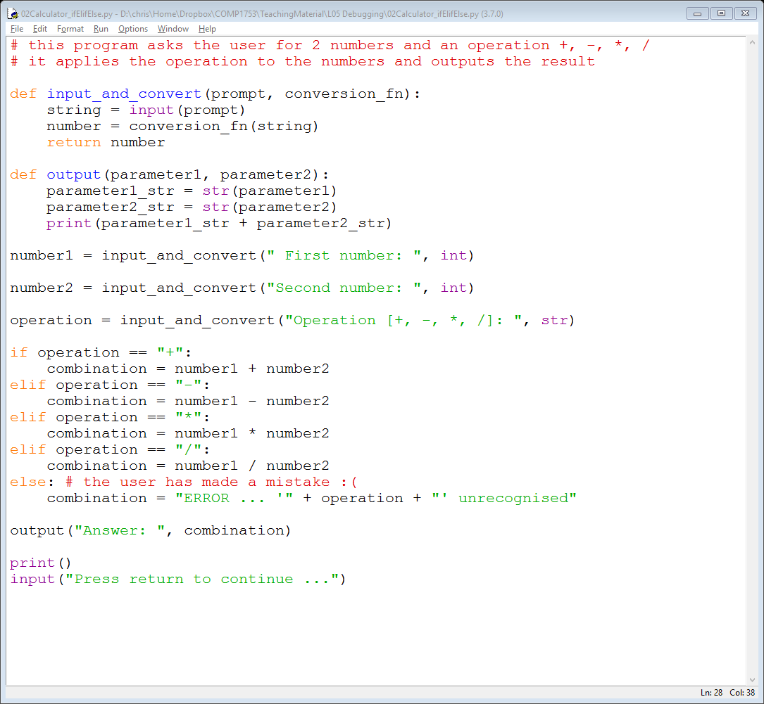
Comments
Comments can be used to explain Python code, and to make it more readable
Python comments can also be used to prevent execution, when testing alternative code
Single line comments start with #
You can also put them after a statement
any text between # and the end of the line will be ignored (will not be executed)

Slide 20
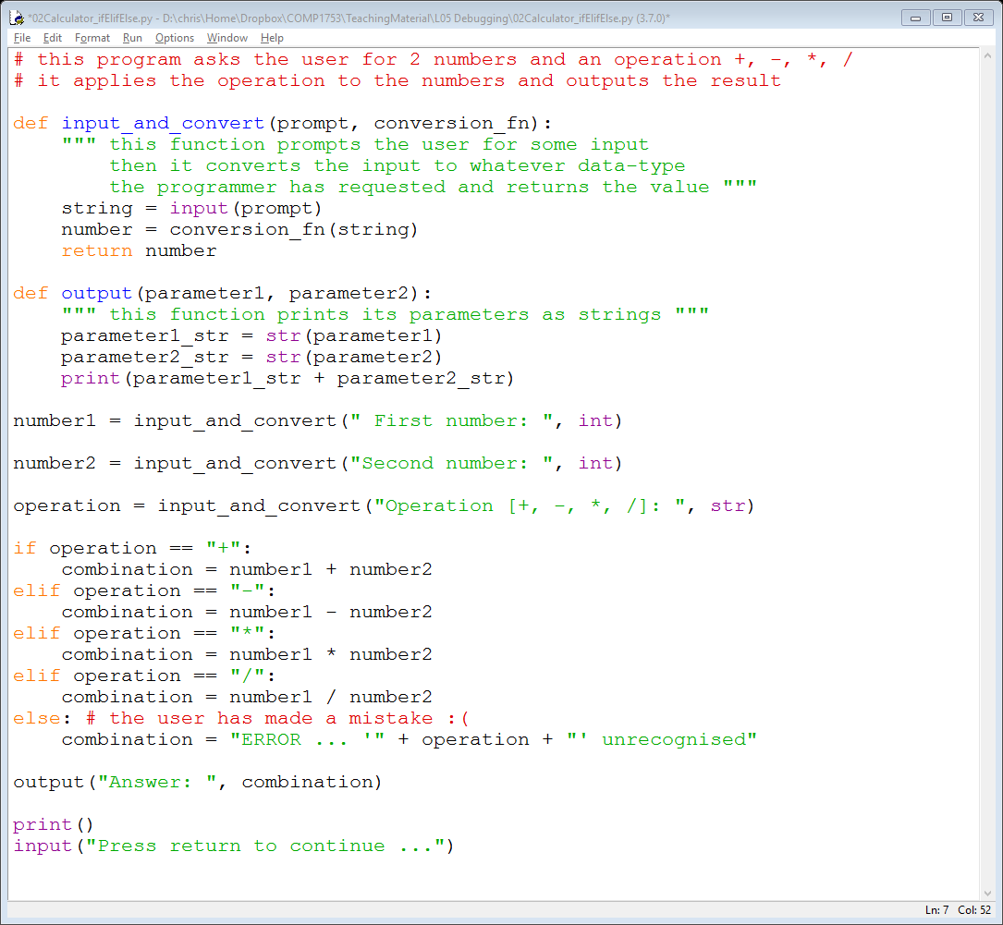
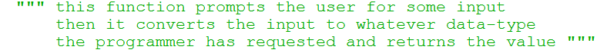
Multi-line comments
Python also has extended documentation capability, called docstrings
we have not met these yet
Docstrings are
often used for describing what a function does
indicated by triple quotes at the beginning and end
Docstrings can be
a single line
multi-line (here the indentation is not meaningful, it just helps with readability)

Slide 21
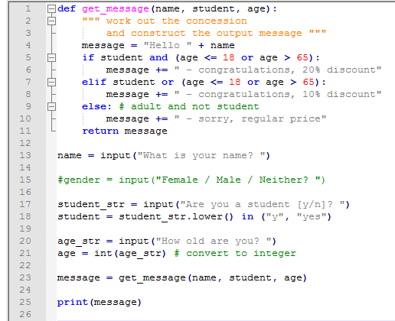
Quick check – can you spot …
The single line comments
answer: lines 9, 15 21
Some executable code that has been commented out
answer: line 15
A multi-line comment
answer: lines 2-3
Statements with 4 operators
answer: lines 5 & 7
NB this code is displayed in NotePad++ (IDLE doesn‘t show line numbers) so the colour coding is different

Slide 22
Debugging
We will spend the rest of the lecture talking about debugging
Debugging is one of the main reasons for using an Integrated Development Environment (IDE)
You can debug Python programs in a variety of IDEs
IDLE has a debugger, but it’s a bit basic
NetBeans (which you will use in term 2 with Java) has a plug-in for debugging Python
You can debug Python in Microsoft’s Visual Studio
… there are others

Slide 23
PyCharm
We shall be working with PyCharm
installed in all the tutorial labs and all 1st & 2nd floor labs in King William
if it’s not installed on in the lab you are working in you can install it from the Software Centre
you can download and install the community edition for free for your own computer at home
PyCharm is developed by JetBrains
also provide IntelliJ (Java), DataGrip for databases / SQL and various .NET plug-ins
https://www.jetbrains.com/

Slide 24
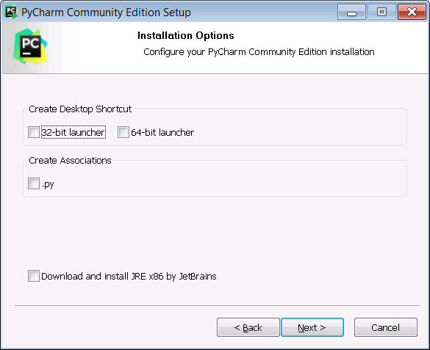
PyCharm installation
Download from https://www.jetbrains.com/pycharm/
make sure you download the Community edition (free), not the Professional (free trial)
Stick to the standard installation
don’t associate .py files with PyCharm (you can change later if you wish)

Slide 25
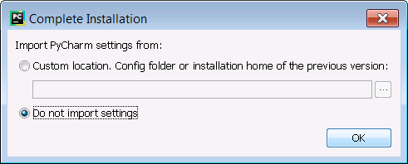
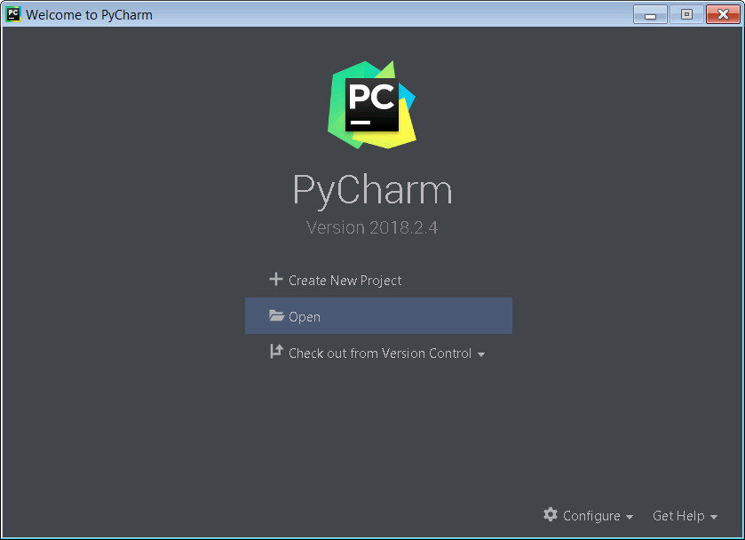
PyCharm settings
Don’t import settings
unless you are already a PyCharm user
You should get a start up screen like this

Slide 26
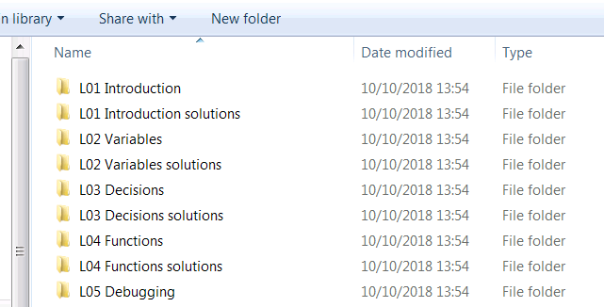
Organising your examples
On this module (and probably all the others) it makes sense to keep your files well organised
i.e. lecture notes, examples, solutions and your own work
makes it easier to find stuff – e.g. during the exam
If you have downloaded everything from Moodle and unzipped to a folder (e.g. called COMP1753) you should have something looking like this

Slide 27
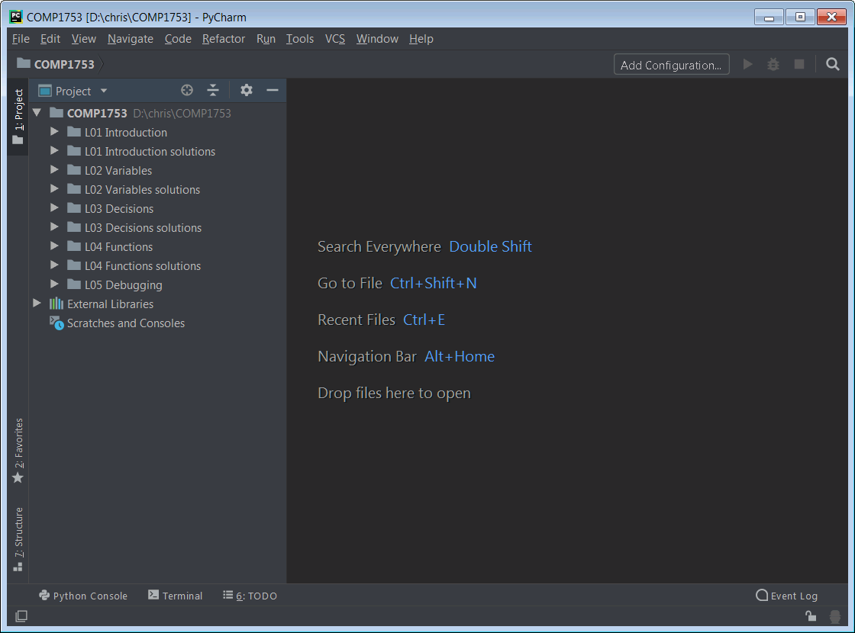
PyCharm
Open this folder in PyCharm
gives easy access to all examples & solutions

Slide 28
PyCharm configuration
PyCharm will regard all of your COMP1753 files as a “project”
PyCharm will create a folder called .idea in this folder which has some configuration files for the project
leave this alone
It’s straightforward to reconfigure the project (e.g. rename it) using the PyCharm menus
but we won’t bother

Slide 29
Running a program
First open a program
let’s work with 02Calculator_ifElifElse from this week’s examples
browse to it in the Files window and double click
You can run a single file like this in several ways
from the menu “Run > Run 02Calculator_ifElifElse”
right-click on the file in the file browser or the code editor and select “Run 02Calculator_ifElifElse”
Ctrl+Shift+F10, or, if you have just run it previously, Shift+F10
Make sure you type your input in the Run window (at the bottom) and not in the code editor!!!
DEMO

Slide 30
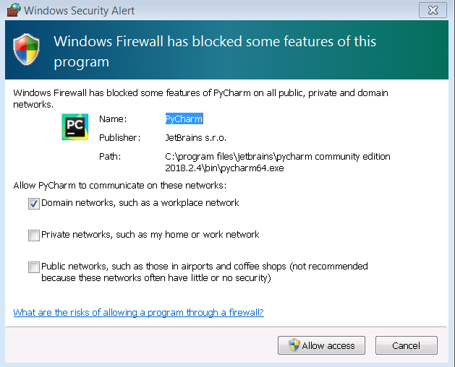
Windows Firewall
The first time you run it you may see a dialog from the Windows Firewall
Click “Allow access”

Slide 31
Debugging
Debugging is the process of removing bugs from a program
including syntax and run-time errors
One way is just to read the program and try to figure out where an error is occurring
fine for short programs, but imagine something like Microsoft Word which probably has hundreds of thousands of lines of code
In the past programmers would print out variable values / status reports at various points to check everything was correct
this is cumbersome and slow
The up-to-date way uses an IDE to run the code and force it to stop the execution where we think something might be wrong, e.g.
at a particular line
when a variable has a particular value
just before a traceback occurs (assuming we know this from previous runs)

Slide 32
Breakpoints
The key tool in our debugging toolbox is the breakpoint
an intentional stopping point within the program
Usually we attach a breakpoint to a line of code
execution of the code pauses at the line
However in some IDEs it is possible to attach a breakpoint to a variable
triggered when the variable changes or even takes on a specific value
we shall not use this technique here

Slide 33
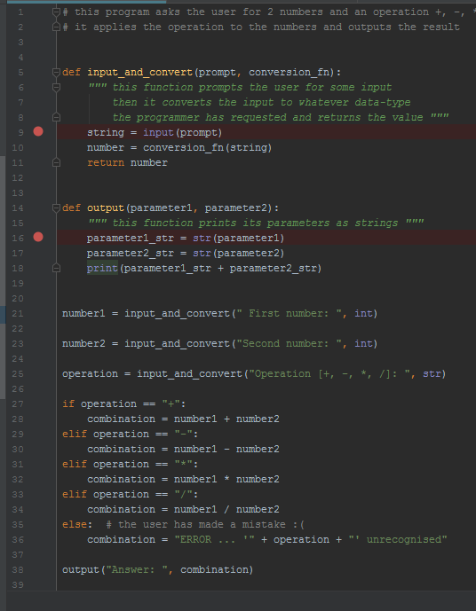
Breakpoints in PyCharm
To set a breakpoint in PyCharm (and most other IDEs) just click between the line number and the line of code
Here we have set two breakpoints
indicated by pink dots
located on lines 9 and 16 (inside the two functions)

Slide 34
Debugging a program
You can start the debugger in several ways
the menu “Run > Debug 02Calculator_ifElifElse”
right-click on the file in the file browser or the code editor and select “Debug 02Calculator_ifElifElse”
if you have just debugged it previously, Shift+F9
Again, make sure you type your input in the Debug Console window (at the bottom) and not in the code editor
Also make sure you create the breakpoints before running the code
or it may just finish before you can stop it

Slide 35
02Calculator_ifElifElse
With the set up as described execution will pause at the first breakpoint in the input_and_convert() function
PyCharm shows the paused position with a blue line
Nothing will have been printed to the console as the input() function has not yet been run

Slide 36
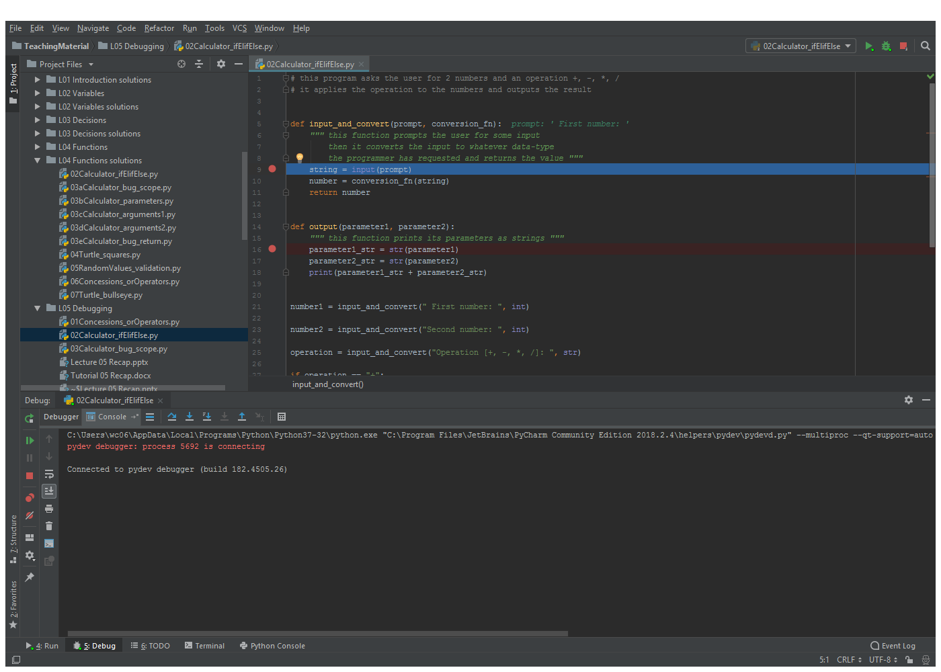
PyCharm screenshot
execution paused here
nothing printed here … yet

Slide 37
Debugging controls
The debugging controls are around the debugging window
Here are the main ones we need
step over to next line (F8)
step into a function (F7)
step out of a function (Shift+F8)
stop [debugging] (Ctrl+F2)
play [continue to the next breakpoint or the end of the program] (F9)

Slide 38
Debugging controls
Now we can use the controls to work through the code slowly
use the play button to continue
use the step over button to step down to the next line in the code (will step over a function call if necessary)
use the step into / out of a function to see what is happening inside a function
By stepping through the code we can usually spot what has gone wrong
PyCharm helps by showing what variables are set to
for example, it would have helped to fix 10Calculator_bug_scope in last week’s tutorial

Slide 39
Other useful features
PyCharm is a very powerful code editor with masses of features
many of which you will never use
The next two slides show some that may be useful

Slide 40
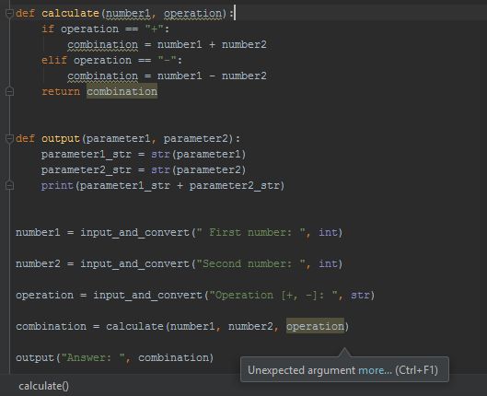
Highlighting problems
it has also spotted that combination may not be assigned (if the user enters something other than + or -)
PyCharm will highlight missing arguments and parameters
Open up programs 11, 12, 13 & 15 from last week to see examples
11 is shown here
PyCharm has spotted the mismatching argument

Slide 41
Syntax errors, Renaming, Usages, Code Completion
If you make a syntax error (e.g. forget a colon : at the end of an if statement)
PyCharm will highlight it with a red squiggle
If you click on a variable and hit Shift+F6 you can rename it everywhere it is used
otherwise you would need to edit them all manually
If you click on a variable and hit Alt+F7
PyCharm will find all the places it is used
If you start typing a variable name
PyCharm will offer a possible list of values (code completion)

Slide 42
Summary
We have reviewed a number of topics
Reminder: course structure & assessment
Python basics: statements, flow of control, operators, comments
PyCharm: installation & configuration, debugging, other features
This week’s tutorial aims to test your debugging skills

